Slide 1
Development of arduino device for Pollution Monitoring

Slide 2
introduction

Slide 3
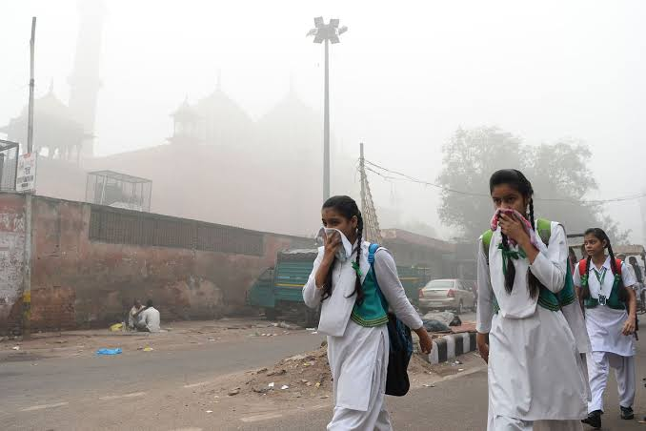


Pollution is a serious concern !!
Oh Really ?

Slide 4

So, What is Pollution?
Pollution is the introduction of contaminants into the natural environment that cause adverse change.
A pollutant is a substance or energy introduced into the environment that has undesired effects

Slide 5
Let’s Talk about Our Device

Slide 6
Pollution
Detector
Device
Pollution

Slide 7
Pollution
Detector
Device
Polluion

Slide 8
Sensor
Modulate A-signals
Pollution
Display
Data
Board Device

Slide 9
Board Device

Slide 10
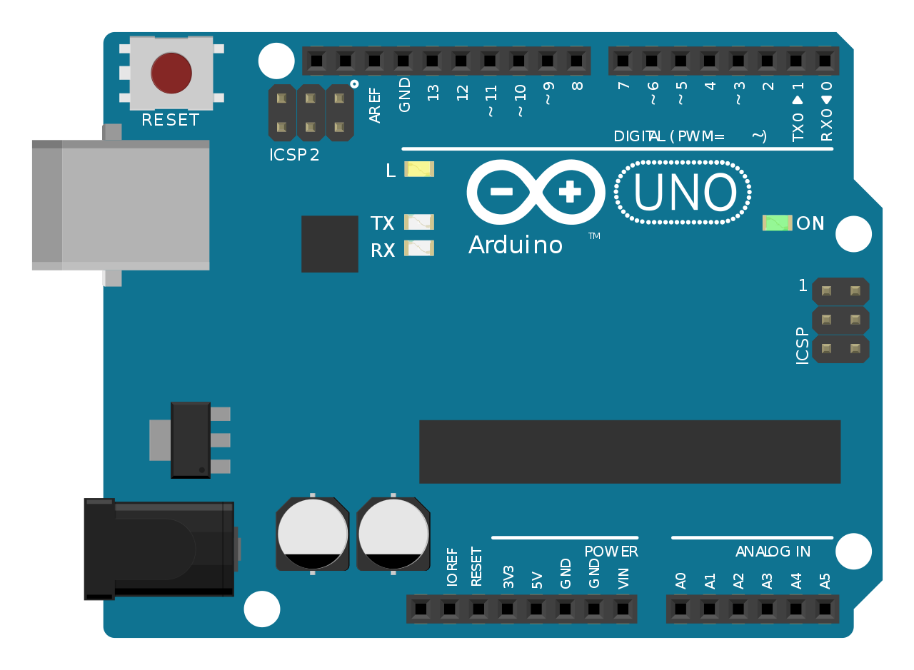
Arduino Device
Digital Pins
USP Port
UIC
Tx & Rx Led
Voltage Regulator
Microcontroller(ATmega328P)
DC Power
Power pins
Analog Pins

Slide 11
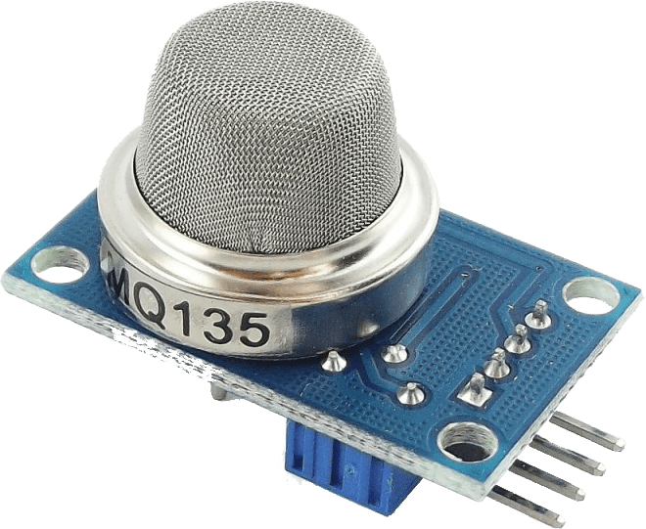
Sensor
MQ135 - Air Quality Gas Sensor Module

Slide 12
MQ Sensors
MQ-2 - Methane, Butane, LPG, smoke
MQ-3 - Alcohol, Ethanol, smoke
MQ-4 - Methane, CNG Gas
MQ-5 - Natural gas, LPG
MQ-6 - LPG, butane gas
MQ-7 - Carbon Monoxide
MQ-8 - Hydrogen Gas
MQ-9 - Carbon Monoxide, flammable gasses
MQ131 - Ozone
MQ135 - Air Quality (CO, Ammonia, Benzene, Alcohol, smoke)
MQ136 - Hydrogen Sulfide gas
MQ137 - Ammonia
MQ138 - Benzene, Toluene, Alcohol, Acetone, Propane, Formaldehyde gas, Hydrogen
MQ214 - Methane, Natural gas
MQ216 - Natural gas, Coal gas

Slide 13
Anti-explosion network
Clamp ring

Slide 14
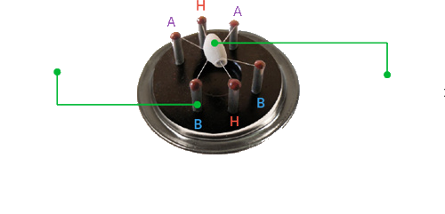
Connecting legs
Sensing Elements

Slide 15

Aluminum Oxide bases ceramic
Coating of tin dioxide
Sensing Element

Slide 16
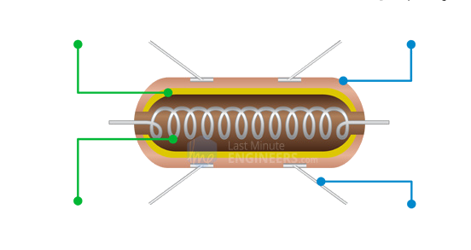
Internal structure of sensing element
Aluminum Oxide bases ceramic
Coating of tin dioxide
Nickel-Chromium coil
Platinum Wires

Slide 17
How does a gas sensor work?
When tin dioxide (semiconductor particles) is heated in air at high temperature, oxygen is adsorbed on the surface. In clean air, donor electrons in tin dioxide are attracted toward oxygen which is adsorbed on the surface of the sensing material. This prevents electric current flow.
In the presence of reducing gases, the surface density of adsorbed oxygen decreases as it reacts with the reducing gases. Electrons are then released into the tin dioxide, allowing current to flow freely through the sensor.

Slide 18
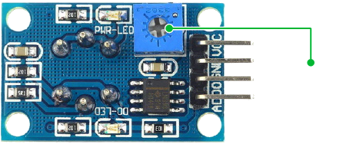
Calibration
Sensitivity adjustment

Slide 19
How we’ll collect Data?
A0
A0
D0
VCC
GND

Slide 21
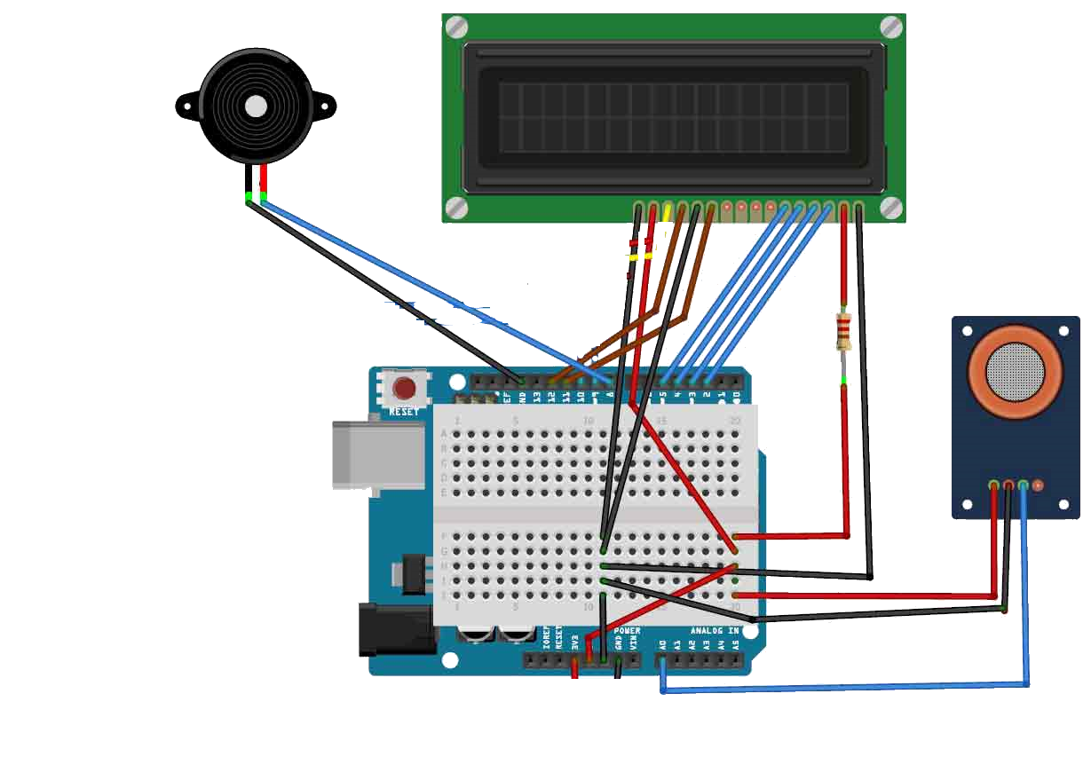
Circuit
Buzzer
LCD
MQ135
BreadBoard
Arduino

Slide 22
Programming
For the sensor:-
#include “MQ135.h”
float MQ135::getPPM() {
return PARA * pow((getResistance()/RZERO), -PARB);
}
//Function used
float MQ135::getResistance() {
int val = analogRead(_pin);
return ((1023./(float)val) * 5. - 1.)*RLOAD;
}

Slide 23
Understanding “MQ135.h” File
#ifndef MQ135_H
#define MQ135_H
#if ARDUINO >= 100
#include "Arduino.h"
#else
#include "WProgram.h"
#endif
/// The load resistance on the board
#define RLOAD 10.0
/// Calibration resistance at atmospheric CO2 level
#define RZERO 76.63
/// Parameters for calculating ppm of CO2 from sensor resistance
#define PARA 116.6020682
#define PARB 2.769034857
/// Parameters to model temperature and humidity dependence
#define CORA 0.00035
#define CORB 0.02718
#define CORC 1.39538
#define CORD 0.0018

Slide 24
Understanding “MQ135.h” File
class MQ135 {
private:
uint8_t _pin;
public:
MQ135(uint8_t pin);
float getCorrectionFactor(float t, float h);
float getResistance();
float getCorrectedResistance(float t, float h);
float getPPM();
float getCorrectedPPM(float t, float h);
float getRZero();
float getCorrectedRZero(float t, float h);
};
#endif

Slide 25
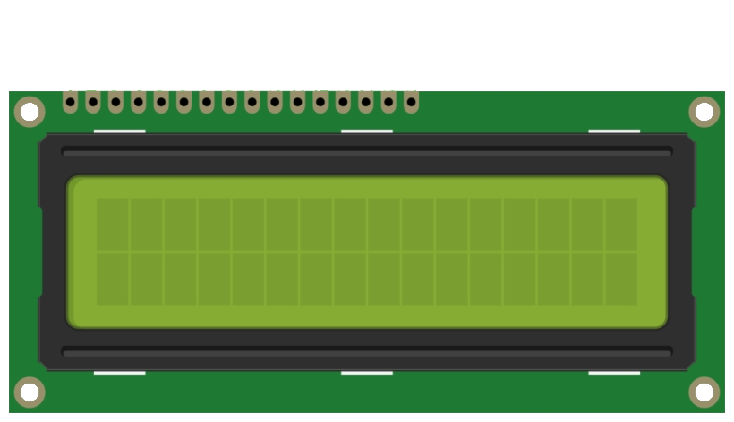
Main Programming
#include "MQ135.h"
#include <SoftwareSerial.h>
#define DEBUG true
const int sensorPin= 0;
int Contrast=80;
int air_quality;
#include <LiquidCrystal.h>
LiquidCrystal lcd(12,11, 5, 4, 3, 2);
void setup() {
pinMode(8, OUTPUT);
analogWrite(6,Contrast);
lcd.begin(16,2);
lcd.setCursor (0,0);
lcd.print ("Pollution Detector ");
lcd.setCursor (0,1);
lcd.print ("Sensor Warming ");
delay(1000);
lcd.clear();
}
Pollution Detector
Sensor Warming

Slide 26
void loop() {
MQ135 gasSensor = MQ135(A1);
float air_quality = gasSensor.getPPM()*1000;
lcd.setCursor (0, 0);
lcd.print (“Level = );
lcd.print (air_quality);
lcd.print (" PPM ");
lcd.setCursor (0,1);
if (air_quality<=1000)
{
lcd.print("Fresh Air");
digitalWrite(8, LOW);
}
else if( air_quality>=1000 && air_quality<=2000 )
{
lcd.print("Poor Air ");
digitalWrite(8, HIGH );
}
else if (air_quality>=2000 )
{
lcd.print("Danger!!");
digitalWrite(8, HIGH); // turn the LED and Buzzer on
}
delay(1000);
}
}

Slide 27
LED = off
Buzzer = off
Level = 135
Fresh Air
LED = on
Buzzer = on
Level = 1100
Poor Air
LED = on
Buzzer = on
Level = 2350
Danger !!

Slide 28
Let’s see demonstration
Video Here

Slide 29
Thanks to you for listening

Slide 30
Any Questions ?

